Slide 1
Cyber Laws, Ethics, and Professionalism in Cybersecurity
Course: Cybersecurity
• Presented By: __________
• Date: __________

Slide 2
Introduction
What is Cybersecurity?
Protection of computer systems, networks, and data from cyber threats.
Ensures confidentiality, integrity, and availability of information.
Requires legal compliance and ethical behavior.
Objectives:
Understand cyber laws and regulations.
Explore ethical and professional issues.
Learn ethical hacking principles.
Discuss cybersecurity certification

Slide 3
Cyber Laws and Regulations
Definition
Cyber laws are legal frameworks governing the use of computers, networks, and digital information.
Purpose
Prevent cybercrime.
Protect privacy and data.
Secure online transactions.
Regulate digital communications

Slide 4
Major Cyber Crimes Covered by Law
Hacking and unauthorized access.
Identity theft.
Phishing attacks.
Malware distribution.
Cyberstalking and online harassment.
Data breaches and theft.
Example: Unauthorized access to a company's database is punishable under cybercrime laws.

Slide 5
International Cyber Laws and Regulations
Key Regulations
European Union General Data Protection Regulation (GDPR)
National Institute of Standards and Technology Cybersecurity Framework
International Organization for Standardization ISO/IEC 27001
Benefits
Data protection.
Privacy preservation.
Security compliance.

Slide 6
Ethical Issues in Cybersecurity
Ethics in Cybersecurity
Ethics refers to moral principles guiding responsible use of technology.
Common Ethical Issues
Unauthorized monitoring.
Privacy violations.
Data misuse.
Insider threats.
Responsible disclosure of vulnerabilities.

Slide 7
Legal Issues in Cybersecurity
Legal Responsibilities
Compliance with regulations.
Data protection obligations.
Incident reporting requirements.
Intellectual property protection.
Consequences of Non-Compliance
Financial penalties.
Legal action.
Reputation damage.
Loss of customer trust.

Slide 8
Professional Issues in Cybersecurity
Professional Responsibilities
Maintain confidentiality.
Protect sensitive information.
Follow organizational policies.
Demonstrate integrity and accountability.
Continuous learning and skill development.
Professional Code of Conduct
Honesty
Responsibility
Respect for privacy
Fairness

Slide 9
Ethical Hacking
What is Ethical Hacking?
Ethical hacking involves legally testing systems to identify vulnerabilities before attackers exploit them.
Goals
Improve security.
Identify weaknesses.
Prevent cyberattacks.
Support compliance efforts.

Slide 10
Types of Ethical Hackers
White Hat Hackers
Authorized security professionals.
Gray Hat Hackers
May identify vulnerabilities without permission but without malicious intent.
Black Hat Hackers
Illegal attackers seeking personal gain or damage.

Slide 11
Ethical Considerations in Hacking
Key Principles
Obtain proper authorization.
Respect privacy.
Avoid causing damage.
Report findings responsibly.
Maintain confidentiality.
Ethical Hacking Process
Authorization
Assessment
Vulnerability Discovery
Reporting
Remediation

Slide 12
Professional Certifications in Cybersecurity
Importance
Validates skills and knowledge.
Enhances career opportunities.
Demonstrates professional competence.
Benefits
Industry recognition.
Higher employability.
Career advancement.

Slide 13
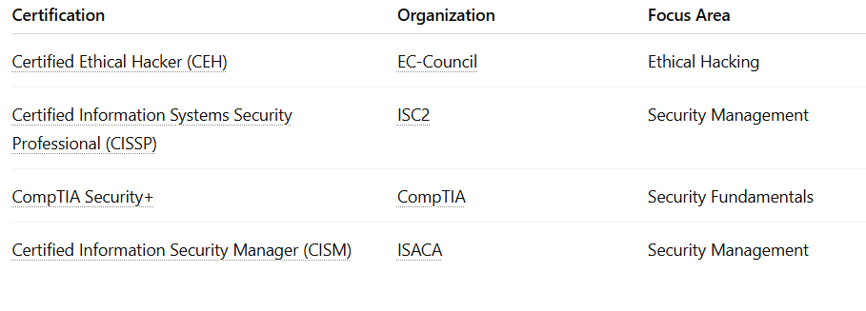
Popular Cybersecurity Certifications

Slide 14
Best Practices for Cybersecurity Professionals
Follow ethical standards.
Stay updated with cyber laws.
Obtain professional certifications.
Conduct regular security assessments.
Promote cybersecurity awareness.
Report vulnerabilities responsibly.

Slide 15
Conclusion
Key Takeaways
Cyber laws protect digital systems and users.
Ethical and legal compliance is essential.
Ethical hacking strengthens security.
Professional certifications enhance expertise and credibility.
Responsible cybersecurity practices help create a safer digital world.

